Slide 1
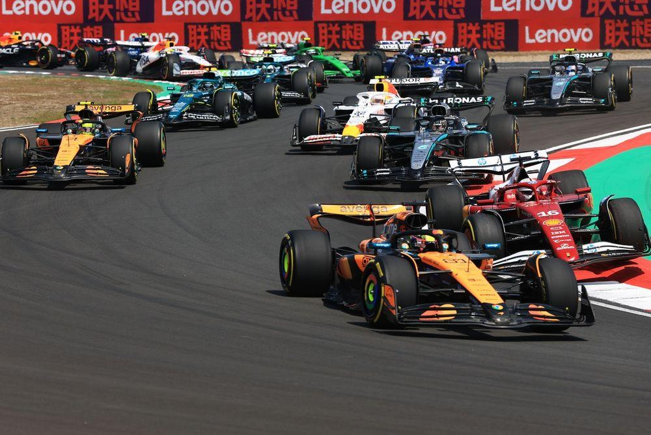
F1 Live Bot: Real-Time Formula 1 Race Updates on Telegram
F1 Live Bot:
Real-Time Updates Receive live race standings and lap times.
Telegram Integration Updates delivered directly to your Telegram chat.
Race Simulation Test mode to simulate historical races for analysis.
Automated Updates Messages update in place for a clean chat experience.

Slide 2
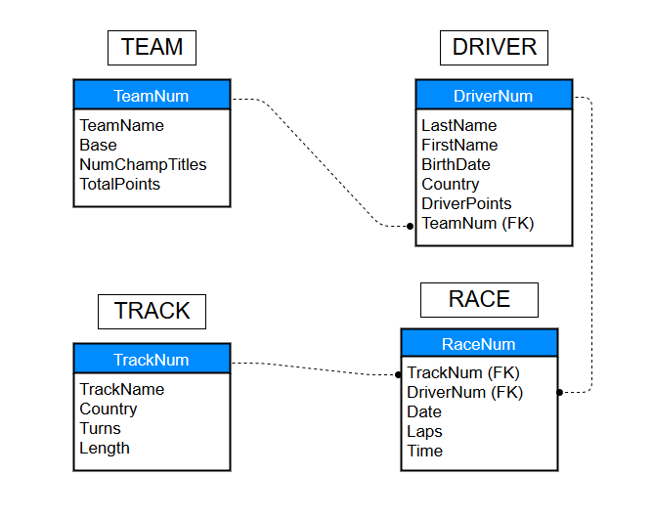
How It Works
Start the System Deploy the Docker containers with your configuration.
Connect Telegram Link your Telegram bot to receive updates.
Track Live Races Automatically fetches data during race weekends.
Simulate Past Races Test mode allows replay of historical races.

Slide 3
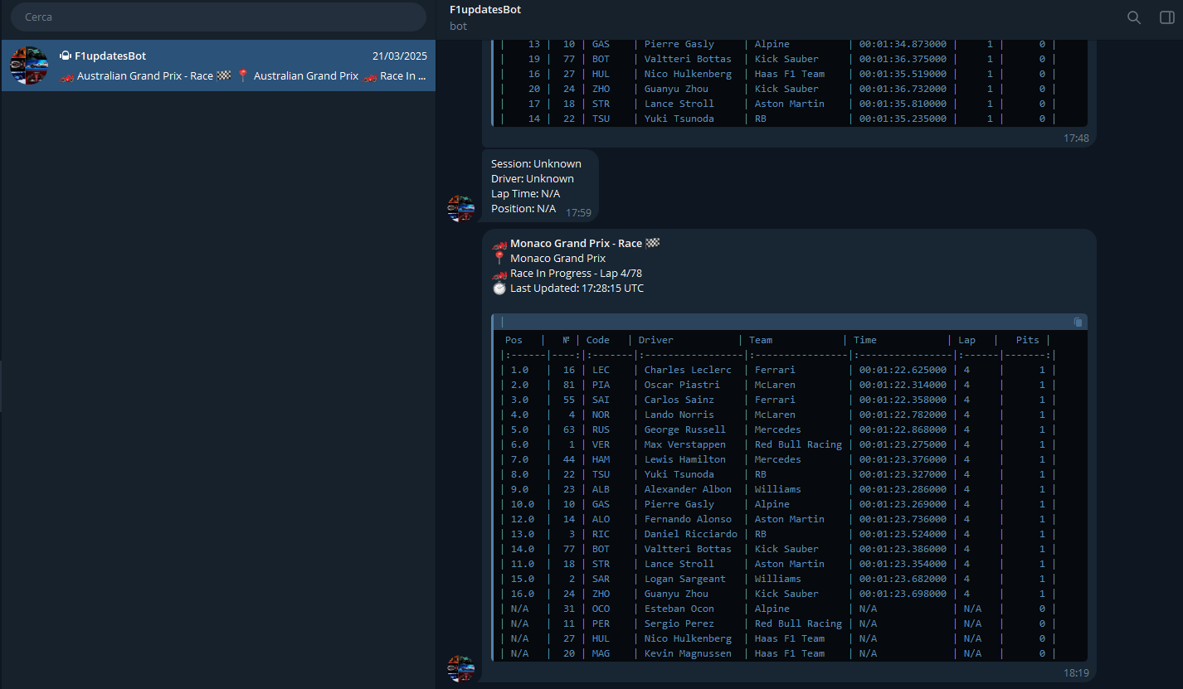
Live Race Updates Features
Position tracking
Lap times
Driver information
Team details
Pit stop counts
Current lap vs. total laps
Real-time standings

Slide 4
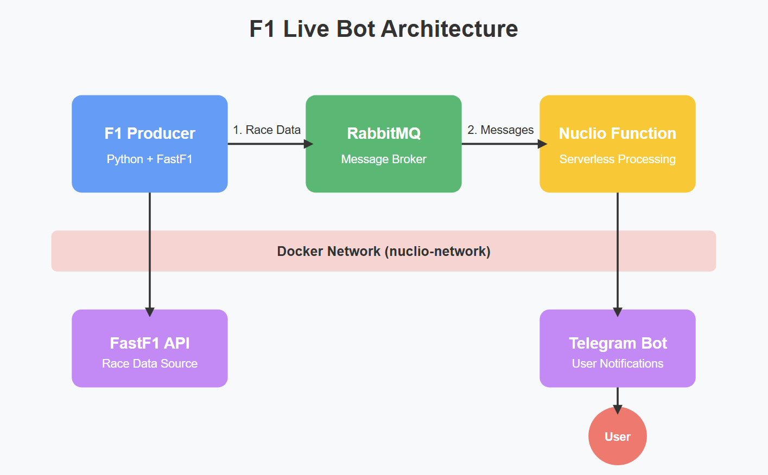
System Architecture
F1 Data Producer Fetches race data from FastF1 API
RabbitMQ Message Broker Handles message queuing between components
Nuclio Serverless Function Processes messages and sends Telegram notifications
Telegram Bot API Delivers formatted race updates to users

Slide 5

Technical Components
Docker Containerization Easily deployable on any system with Docker support.
FastF1 API Integration Professional-grade F1 timing data source.
Message Queue Architecture Reliable message delivery with RabbitMQ.
Serverless Processing Efficient message handling with Nuclio functions.

Slide 6
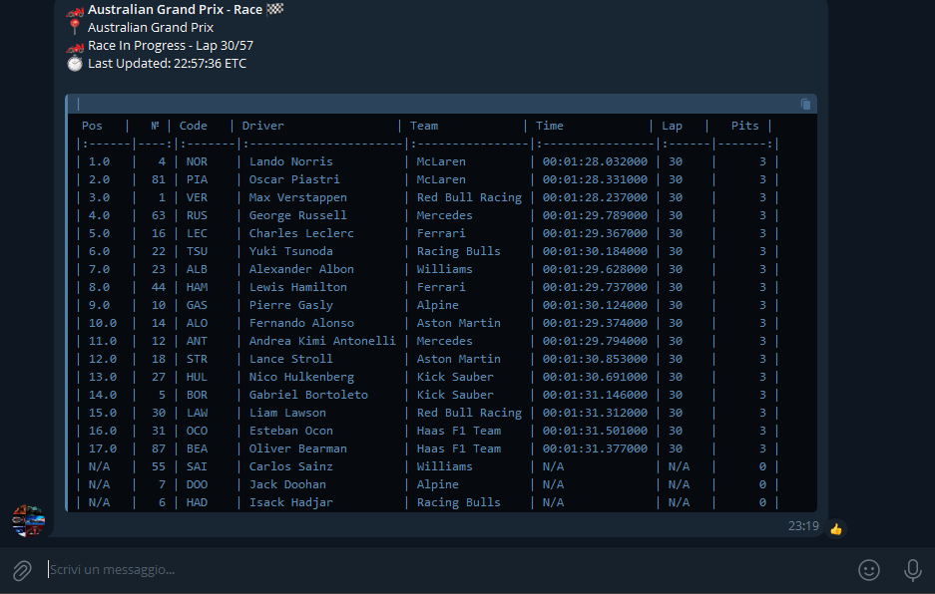
Advantages of F1 Live Bot
Free No subscription costs for basic functionality.
Available 24/7 Accessible whenever races are happening.
Familiar Interface Uses the Telegram platform you already know.
Customizable Configure update frequency and test modes.

Slide 7
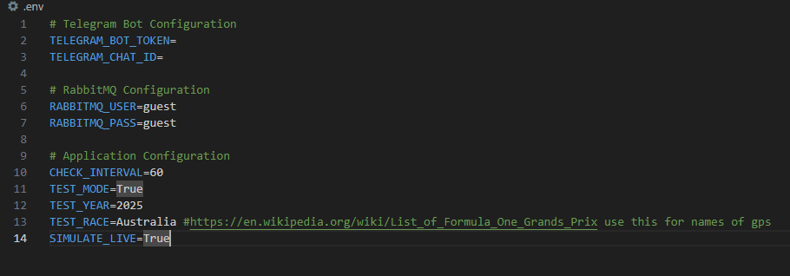
Configuration Options
Race update frequency
Test mode with historical races
Race selection by year and event
Live race simulation speed
Starting lap configuration

Slide 8
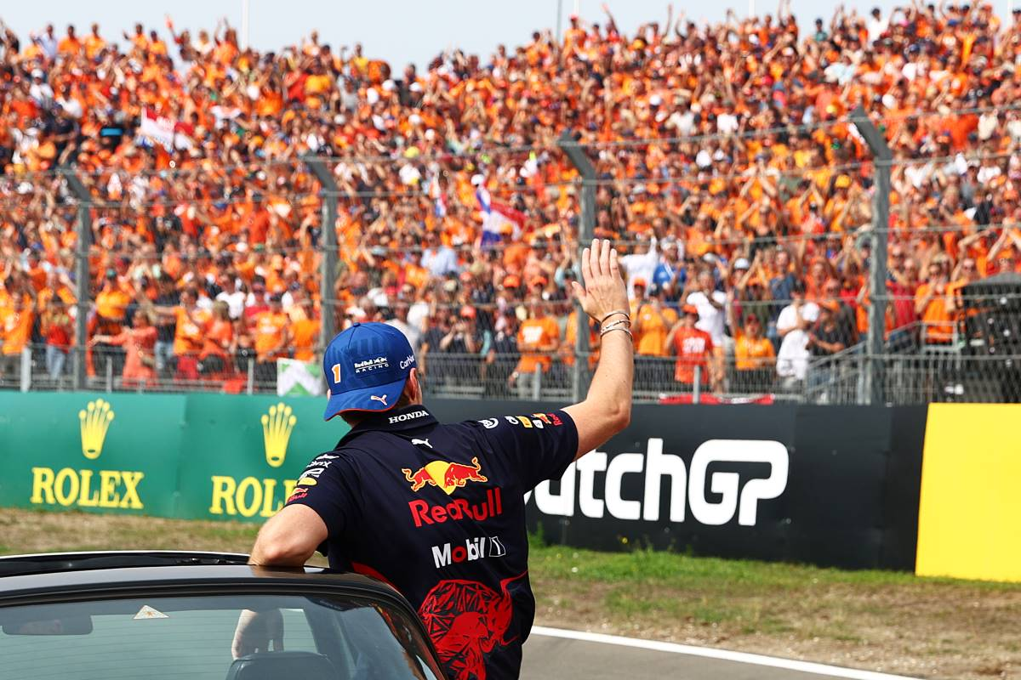
Future Development
Short Term:
Driver-specific alerts
Race prediction features
Customizable update formatting
Long Term:
Multi-language support
Weather integration
Strategy predictions
Web dashboard interface

Slide 9
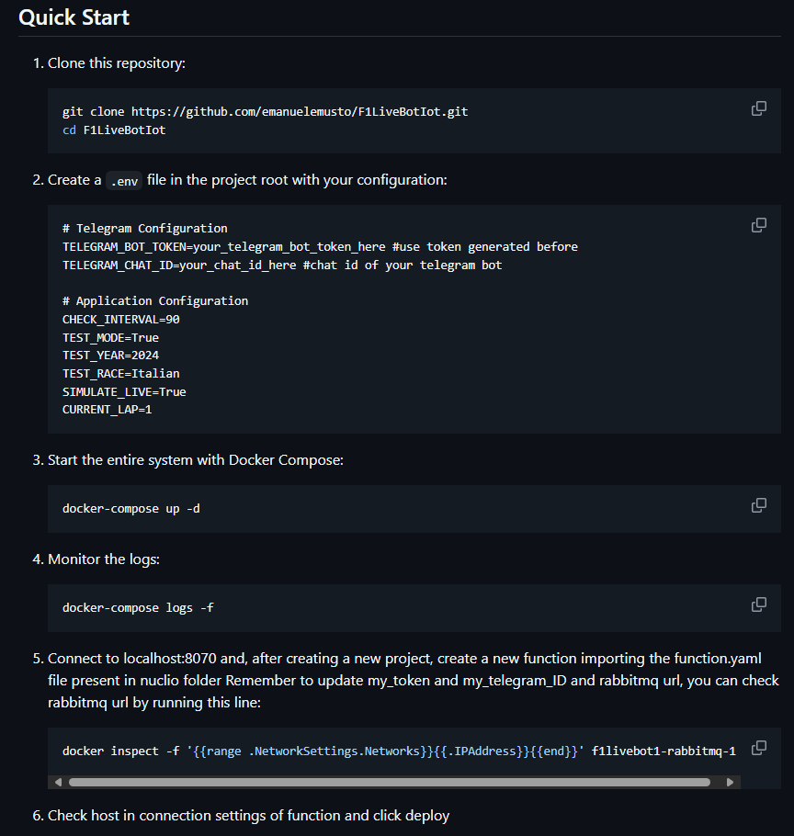
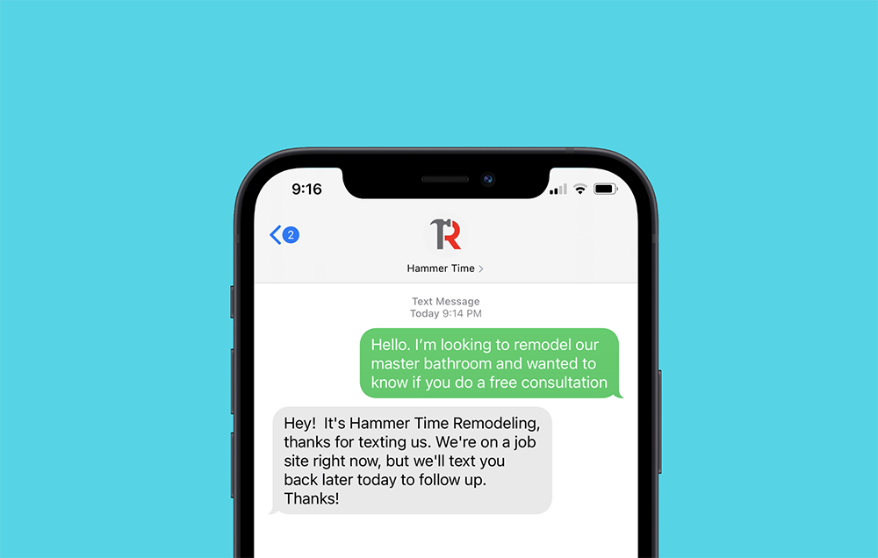
Start Now with F1 Live Bot
Set Up Docker Install Docker and Docker Compose.
Create Telegram Bot Get a token from @BotFather.
Deploy the System Follow the quick start guide.
Enjoy Real-Time Updates Experience F1 races like never before. GitHub - emanuelemusto/F1LiveBotIot

